Slide 1

VODAFONE MESSAGE HUB - VMH
VMH
Operator
P2P
Technical Know-how
OBR at VRS side to intercept relevant messages:
SendRoutingInfoSM (OpCode = 45)
RespSMDeliveryStatus (OpCode = 47)
Creating new policing / adapting existing policy tree to cope with combination of services:
SoR+SMSHub
SMSHub
Use of specific TT for loop prevention and service colouring:
TT=120: Set by VRS in the messages intercepted which must be routed to Syniverse
TT=121: Set by Syniverse for the messages which have already passed through the SMS-HUB logic, and must be routed to the VF-OpCo
GT routing unfolding: specific VF-OpCo GTs are now used by Syniverse, so must be routed from VF-OpCo and VRS to Syniverse
TT=120
TT=121
VRS Hub
Local Markets
Operator
SMS Generators
VMH
A2P
SMPP connection
VMH Goals
SMS Generators
Local Markets
Setting up an SMS-HUB to simplify the contractual part (AA.19)
Cost optimizatoin & Revenue maximization
Increased Footprint
Enhanced billing
Grey routes detection
Commercial SMS-HUB offered to 3rd party customers
Centralized QoS and SLA Management
SMS Gateway for Vodafone (inbound & outbound)
Enhanced Security features
Fraud control
SPAM blocking
Better customer experience
VRS Hub
Other SMS-Hubs
GT on CdPA belongs to VMH
Other operators

Slide 2
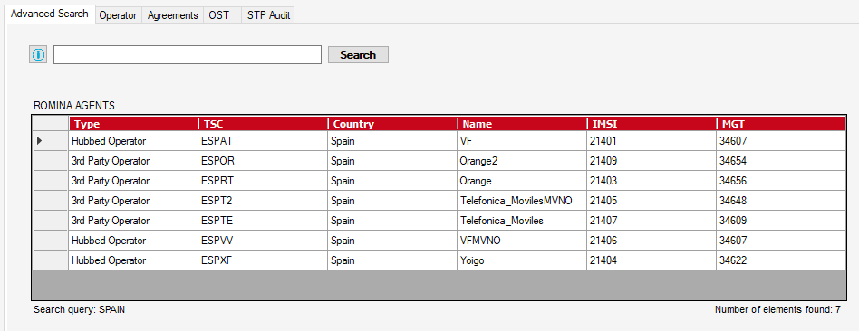
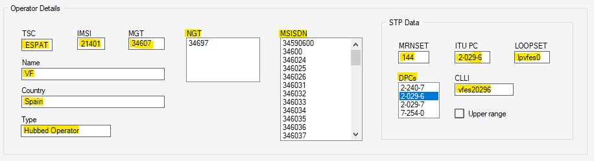
Search query typed in textbox
Number of elements found in query

Slide 3
Copies both the entire list by clicking MSISDN and an specific value by clicking each one
If marked reports that routing data is related to an upper range that affects operator MGT

Slide 4
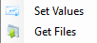
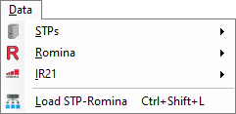
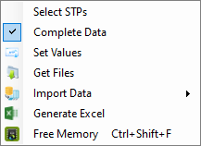
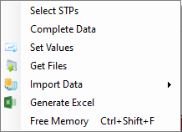
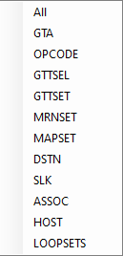
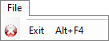
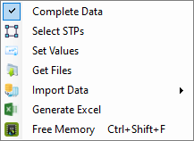
Selects STPs from which data will be loaded
Determines if all data included in source files will be loaded
Loads Romina and all STPs data
Generates Excel with all STPs loaded data
Frees memory by removing STPs loaded data
Loads all or each specific module data in memory

Slide 5
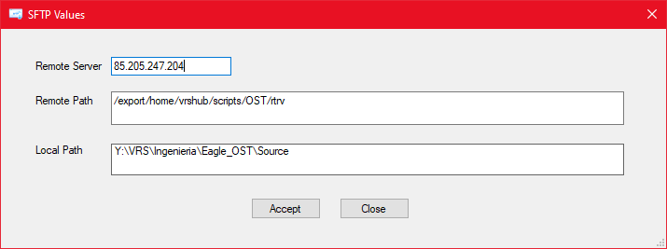
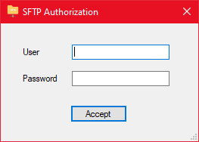
SFTP values needed to obtain source files of OST from Eagle STPs
User and Password of user to connect to machine with source files by SFTP

Slide 6
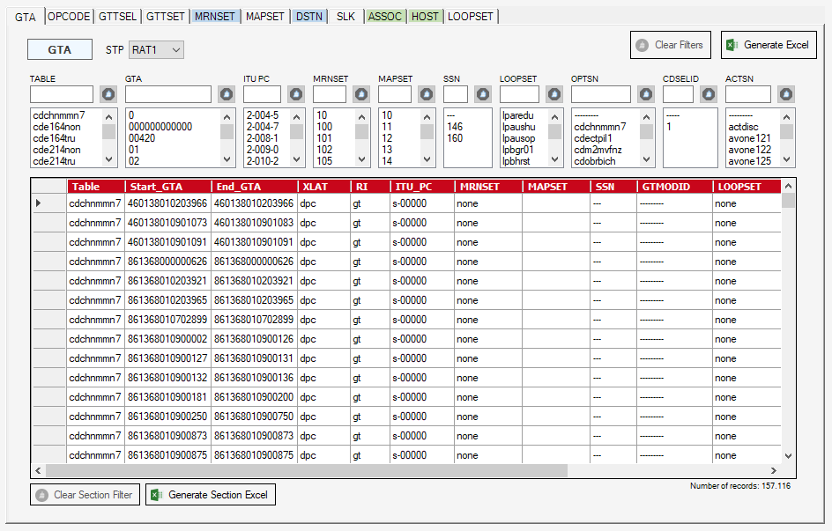
Each of the STPs info can be selected in case it has been loaded (only affects current section)
Sections with the same colour have some depencies to show all data values
Clears all filters applied in any section
Generates an Excel file with all OST data loaded, taking in consideration any filter applied
Clears filter applied in current section
Generates Excel file with current section taking in consideration applied filter
Number of records taking in consideration applied filter

Slide 7
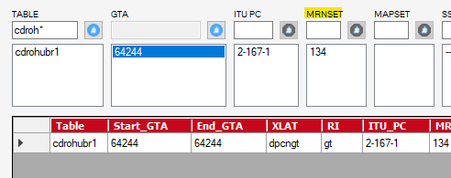
Upper range configured
Subrange configured
Textbox filter
By clicking each of the headers, all elements in list will copied to the system clipboard
Clears filter
List selection filter

Slide 8
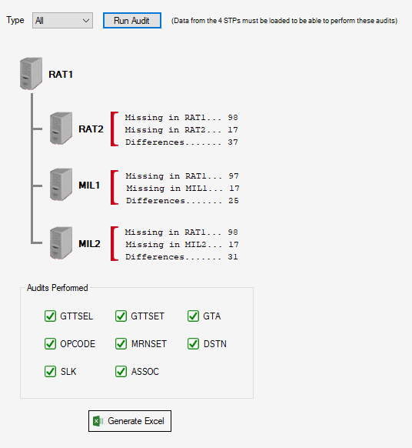
Audit type to be performed
Generates an Excel will all audits result

Slide 9
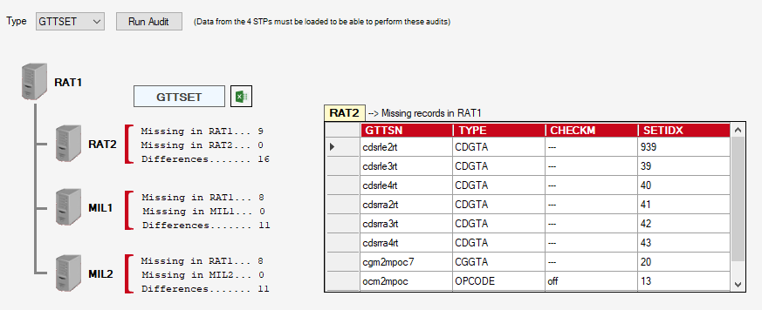
Button to generate Excel file with current module audit results

Slide 10
